Slide 1
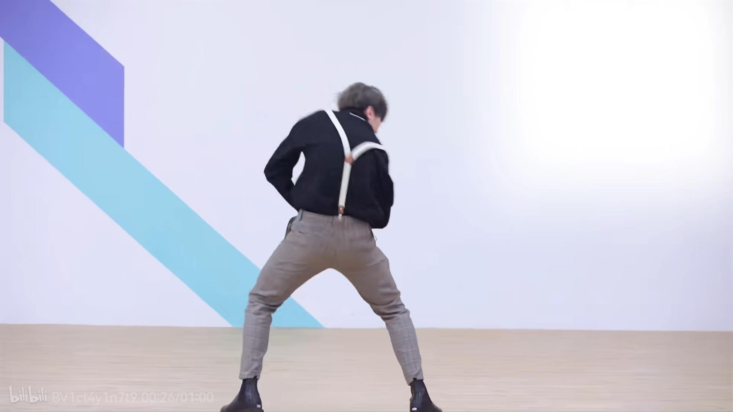
ikun文化
Ikun Culture

Slide 2


1.Origin of ikun culture
3.Accident of ikun
2.Development of ikun culture
4.Ikun culture: forever
top

Slide 3


Part 1.Origin of ikun culture

Slide 4
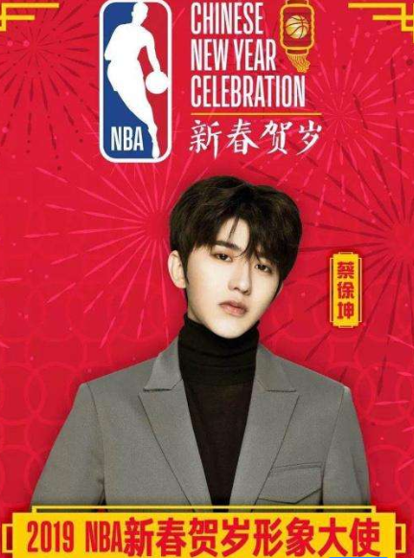
At the end of 2019,accounted by NBA , Cai Xukun became the first image ambassador of NBA that celebrate the New Year . But this action made many people that Hupu App user especially dissatisfied , even angry because they thought Cai Xukun had no qualification to represent NBA and it affronted Chinese basketball .
Thus , they created kuso video based on a video that he played basketball in a program in 2018 to make fun of him .Beisdes , the lyrics ”Just because you are beautiful”(只因你太美) were misheard as “Chicken you are beautiful”(鸡你太美) due to being sung too quickly in video , and it had become a popular internet meme. Soon , bilibili platform was full of this kind of video and Cai Xukun became a person whom netizen enjoyed making fun of the most . At the beginning ,it was useless that the team of Cai Xukun had been issuing lawyer’s letter to stop these behavior .
Later , with he no longer bothering about this , netizen reduced fooling him .

Slide 5

Part 2. Development of ikun culture

Slide 6
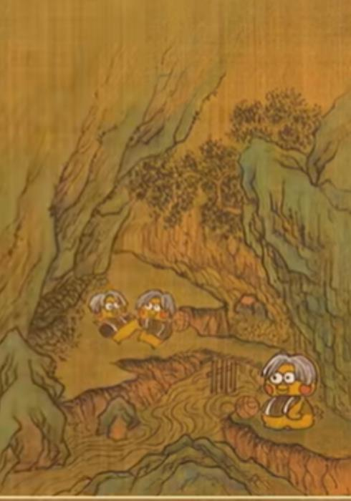
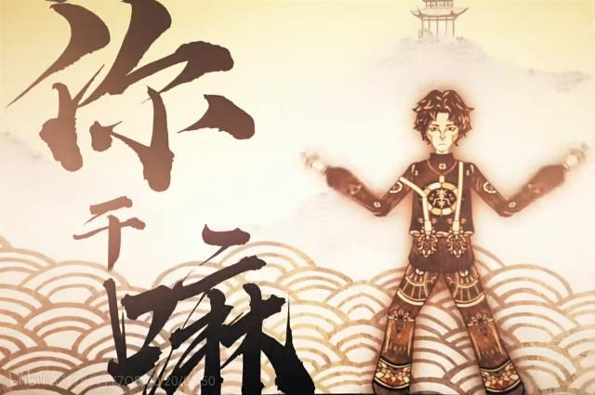
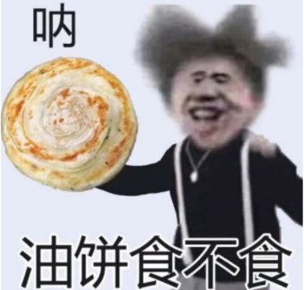
However , by 2022 , a content creator named YoYo Ball Chen Zong caused a stir once again . In his videos , he utilized the controversial materials of Cai Xukun , reigniting a second wave of parody frenzy .
Compared to four years ago, the creators have far surpassed their previous technical and creative abilities . As a result , a batch of higher-quality and parodied videos had been produced . Many phrases such as“本来挺喜欢你的，现在更喜欢了”,”我家哥哥” and “你干嘛” became public signals . Gradually , this meme has evolved into a “ikun culture” and it spans across multiple age groups . “坤” not only is called chicken,that “鸡” in Chinese by People but also become a unit of measurement, reprsenting two point five. Everyone who plays this meme calls themselves “Xiao Heizi”(小黑子) or ”ikun”(爱坤) .

Slide 7
Part 3.Accident of ikun

Slide 8
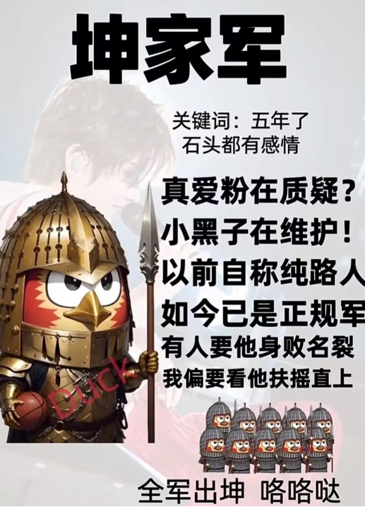

Unexpectedly , in June 2023 , the media exposed negative news about Cai Xukun having improper relationship with a Miss C. Different from other stars , organization named “Xiao Heizi” kept advocating him .They didn’t believe this new was true and want to lose Cai Xukun. What is their slogon is “巅峰产生虚伪的拥护，黄昏见证虔诚的信徒”.
At that time , Cai Xukun and “ikun culture” were known by more people and popularity of ”ikun culture” had reached an unprecedented height .Additionally, he has gained over a million new followers accross all platforms, and his merchandise is selling like hotcakes all over the country.On the contrary, newspaper office People’s Daily, which criticized the ikun culture, lost over 40million points. Finally, admitted by Cai Xukun , negative news are true. From then on, “ikun culture” lost its biggest cultural carrier .

Slide 9

Part 4.Ikun culture: forever top

Slide 10
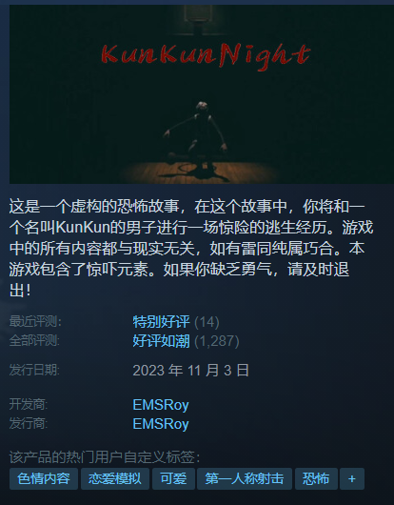
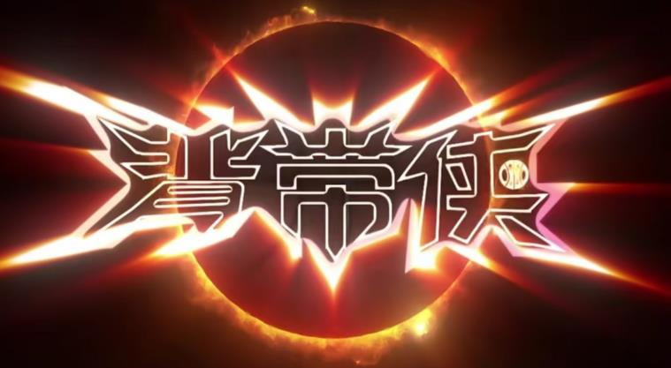
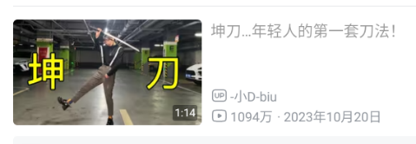
Cai Xukun may have faded from public slight , but “ikun culture” never stop its development . As of today , “ikun culture” still has significant influence and people continue to tap into its immense popularity . You can see it in all kinds of fields. “Beidai Superman” , ”fist position of kun”,game named “kunkun night” and so on are created and spread widely . It has not been attached to Cai Xukun and developed into a completely individual culture , becoming a spiritual belief for contemporary netizens . In my opinion , ”ikun culture” is timeless !

Slide 11


Slide 12

Thanks for your listening!

